Slide 1
Public Transportation Priorities
More operational funding for MBTA
Line-by-line rail improvement plan
Next: Worcester and Fitchburg line solutions
Will Brownsberger, WillBrownsberger.com, January 2020

Slide 2
MBTA capital spending is up dramatically, but operating expenses have been held down.
Sources: Audited Financial Statements; MBTA Board Presentation, April 8, 2019;

Slide 3
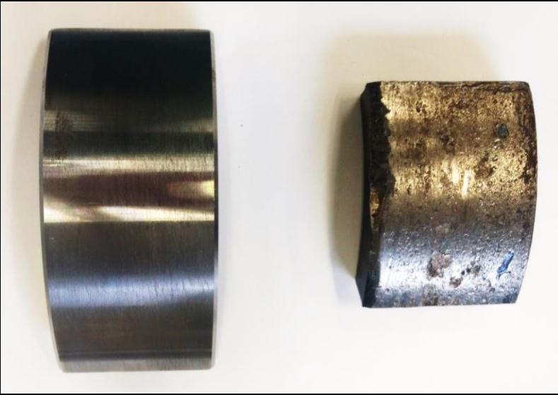
Undermanagement of maintenance
Critical [Preventative Maintenance and Inspections] are not taking place as required. . .
[D]ue to shortage of and/or inexperienced leadership, competing priorities and fiscal controls, operational managers have had difficulty identifying what maintenance and inspections need to be done, or have been dropped due to fiscal pressures or lack of staffing.
Safety Review Panel, Final Report, December 9, 2019
https://cdn.mbta.com/sites/default/files/2019-12/2019-12-09-fmcb-B-safety-review-panel-final-report-accessible.pdf

Slide 4
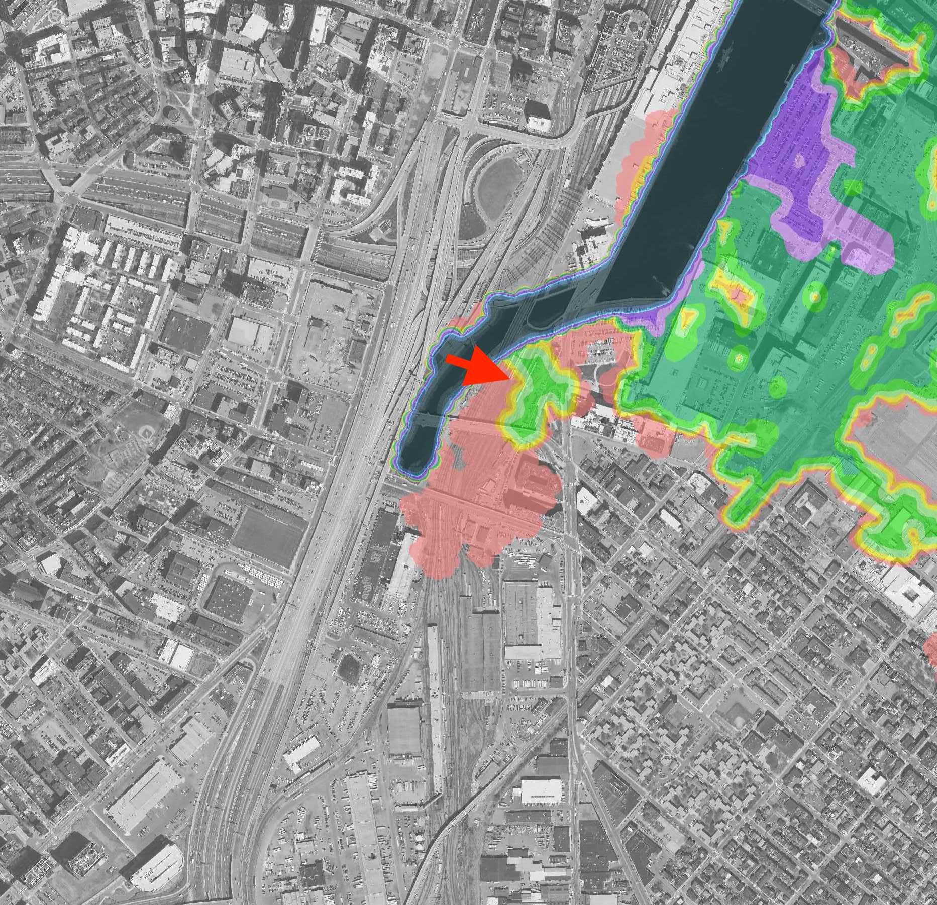
Undermanagement of resiliency
Sources: WB photo, Woods Hole Group flood mapping

Slide 5
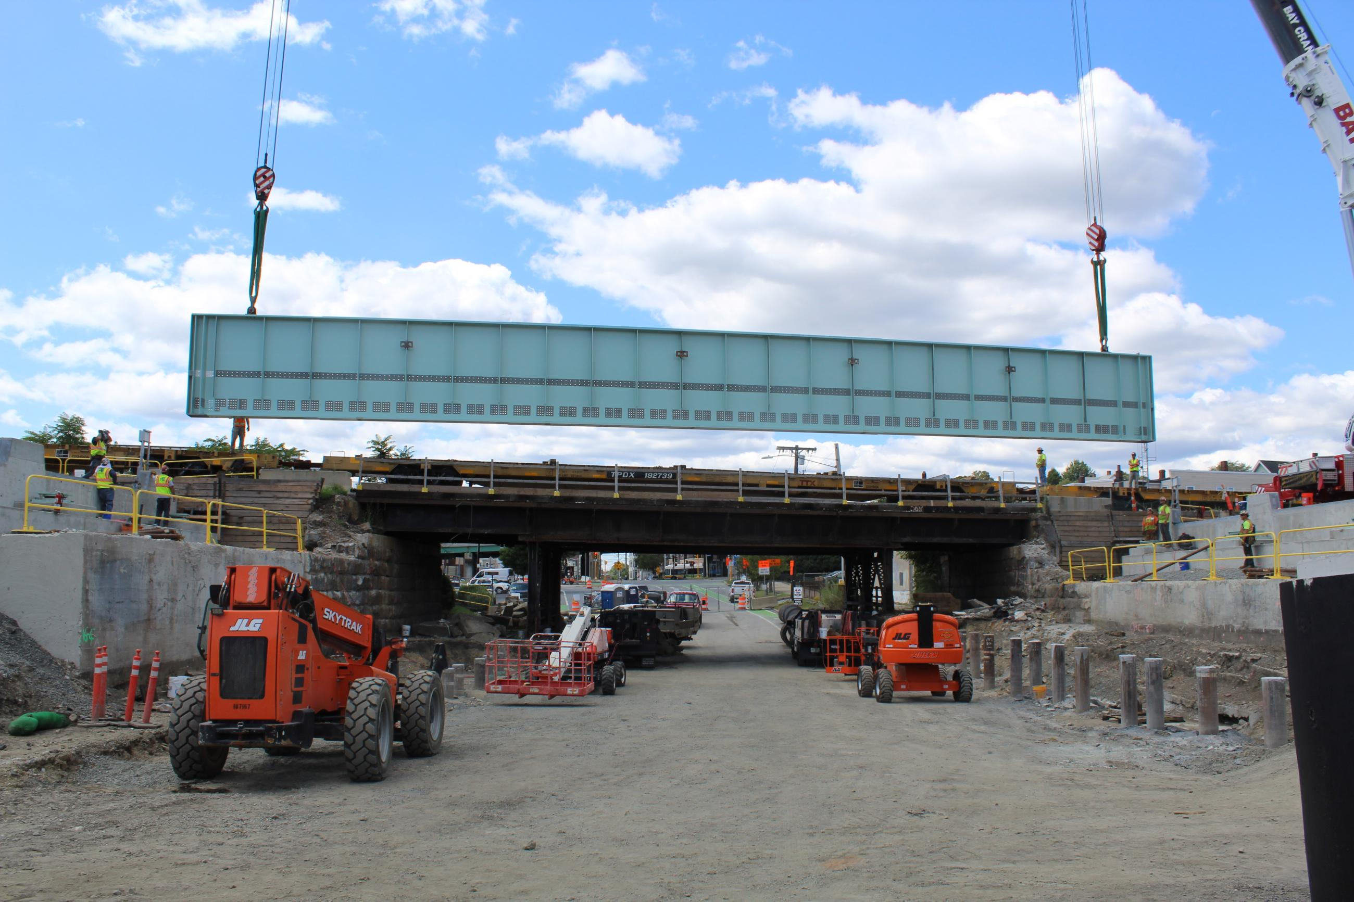
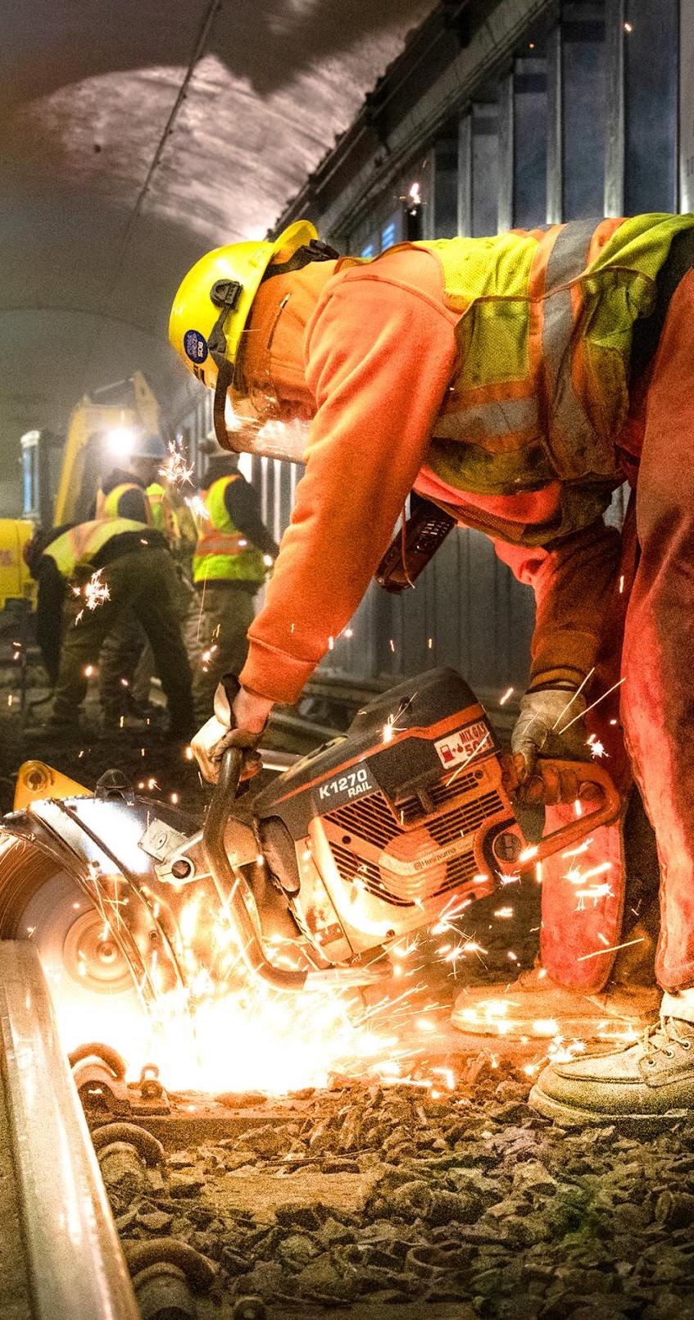
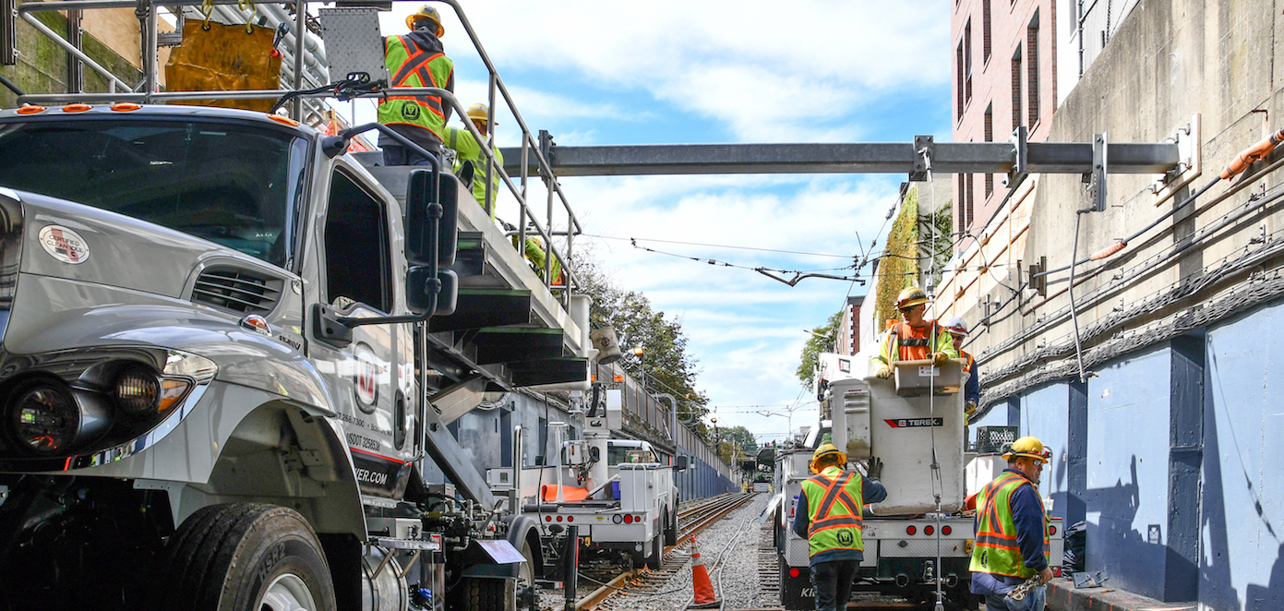
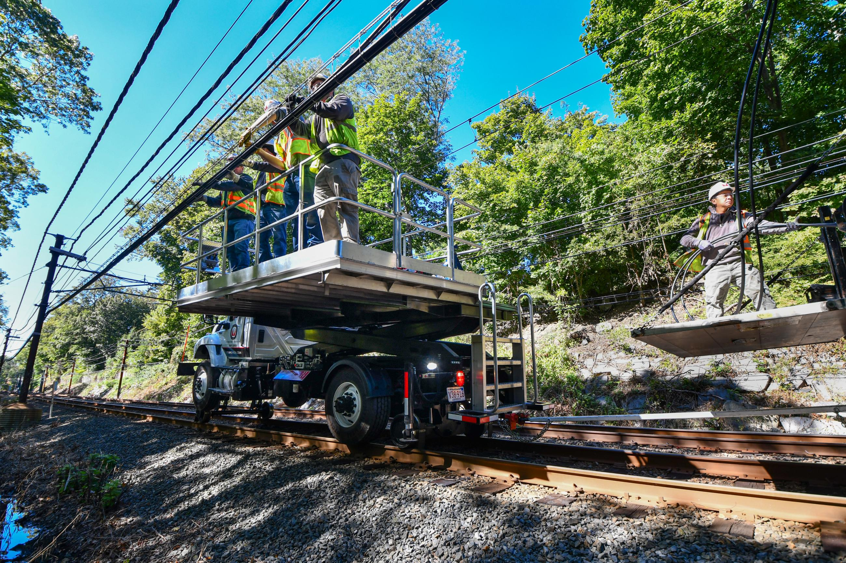
Undermanagement of construction
Photo Sources: WB Photo of bus tunnel; other project photos from mbta.com

Slide 6
Undermanagement of operations
Lack of dynamic response to bus route conditions
Customer communications often poor
Limited ability to control/absorb absenteeism
. . .

Slide 7
Fares rising much faster than cost of living
Sources: Fares from en.wikipedia.org/wiki/Massachusetts_Bay_Transportation_Authority CPI data from beta.bls.gov/dataViewer/view/timeseries/CUSR0000SA0

Slide 8
More annual operational funding for MBTA
Needed for present quality of service
Needed to develop capacity to build for the future
State should transfer more annually to the MBTA
No consensus yet on how much to transfer or how to fund the transfer

Slide 9
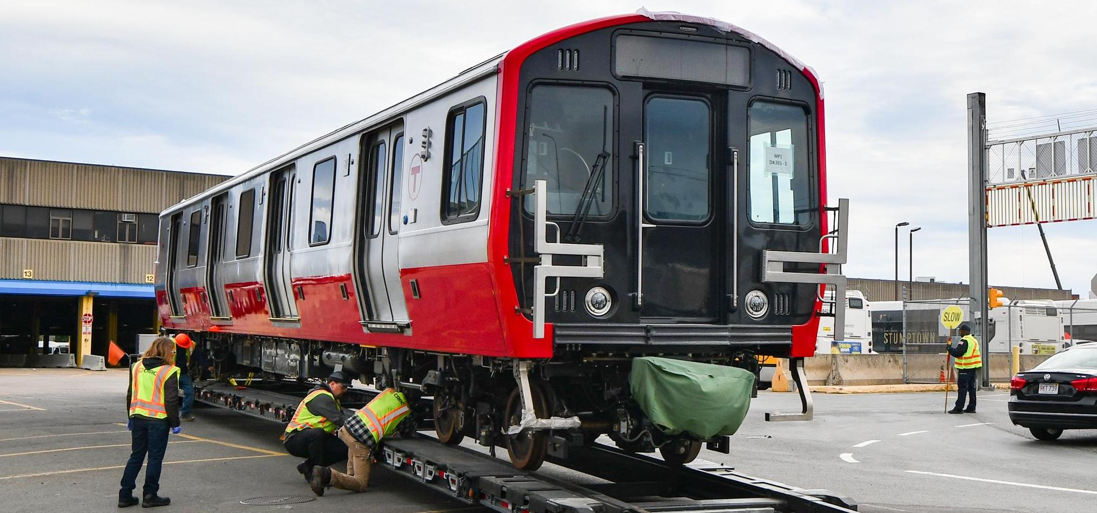
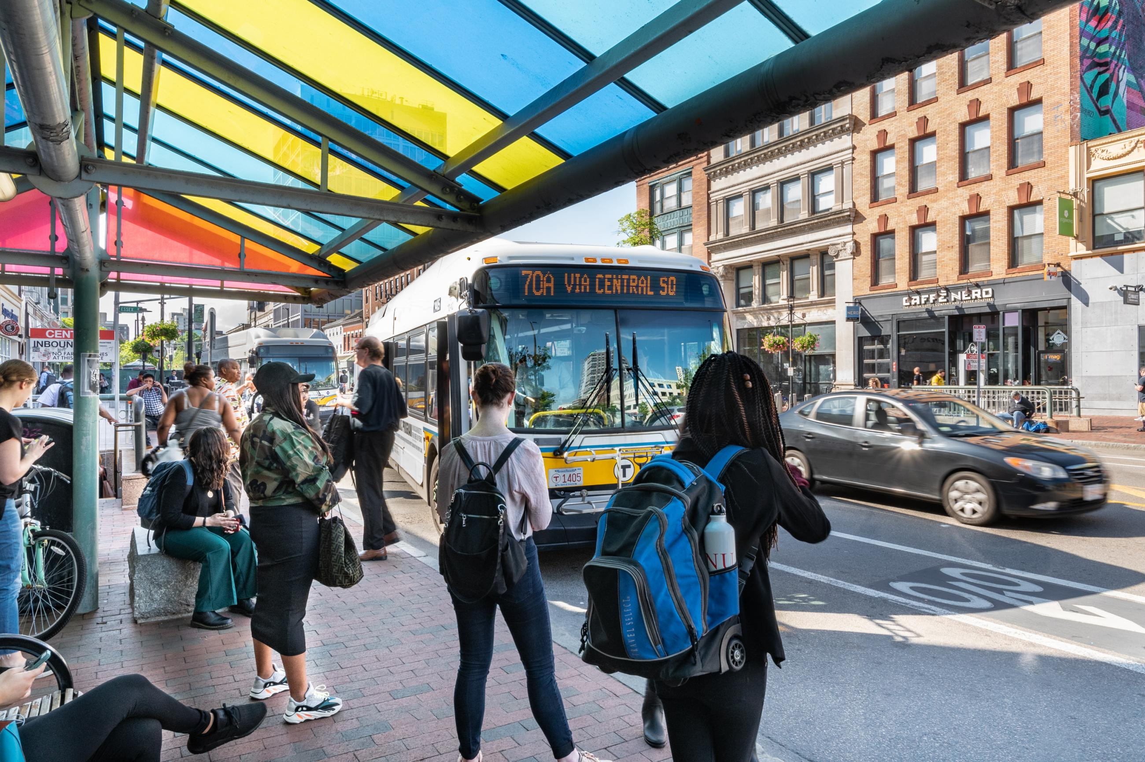
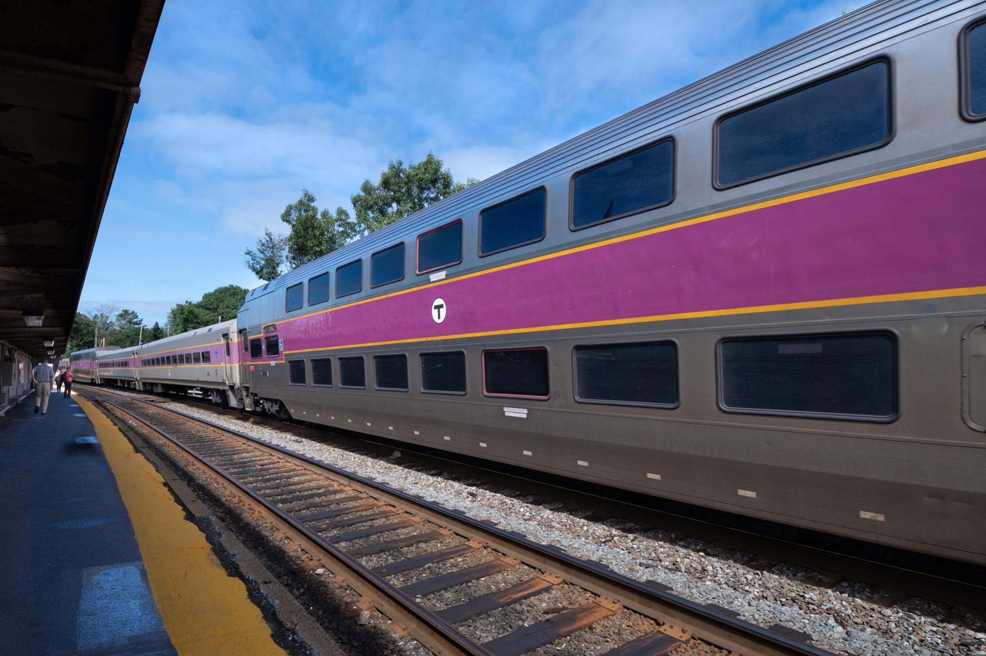
MBTA plans are in good focus except for rail
?
Photos Source: https://mbta.com/

Slide 10
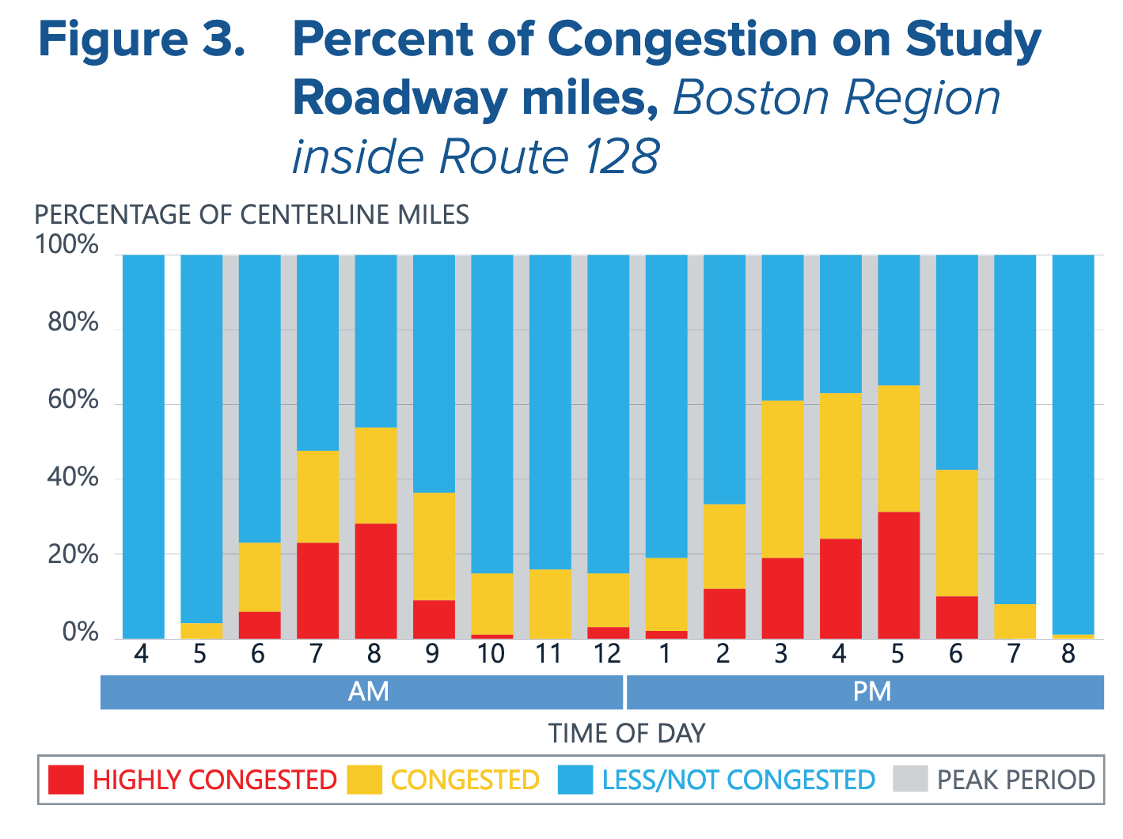
Congestion bad and getting worse
Image
Source: MassDOT, Congestion in the Commonwealth

Slide 11
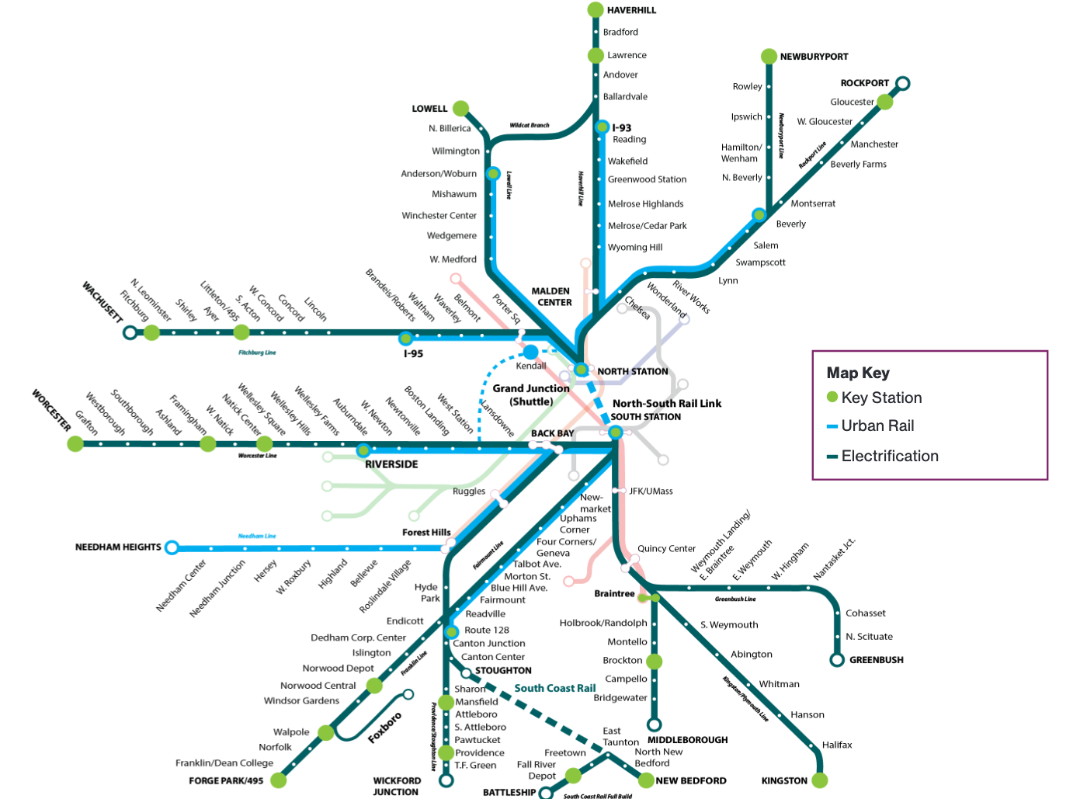
Regional rail -- vision
Regional Rail – sustainable, equitable, fully connected

Slide 12
Annual net cost per daily transit rider
Full Transformation per new rider (+capital) | $30,284
Full Transformation per new (ex capital) | $9,199
Full transformation, all riders (ex capital) | $4,985
Current commuter rail (ex capital) | $2,260
Subway (ex capital) | $249
Green line (ex capital) | $1,212
Bus (ex capital) | $1,610
Source: Calculations from Rail Vision Advisory Committee Presentation, October 18, 2019 and
2018 National Transit Database

Slide 13
Can Rail Reduce Congestion?
AM Rush Hour Pike Corridor Travelers
Source: https://willbrownsberger.com/rail-at-rush-hour/

Slide 14
New riders per new trip in Commuter Rail Vision Option 3
Source: Calculations based on Rail Vision Presentation to FMCB meeting, July 22, 2019

Slide 15
In any expansion, need ridership ROI ($, GHG)
Source: https://willbrownsberger.com/transit-energy-efficiency/

Slide 16
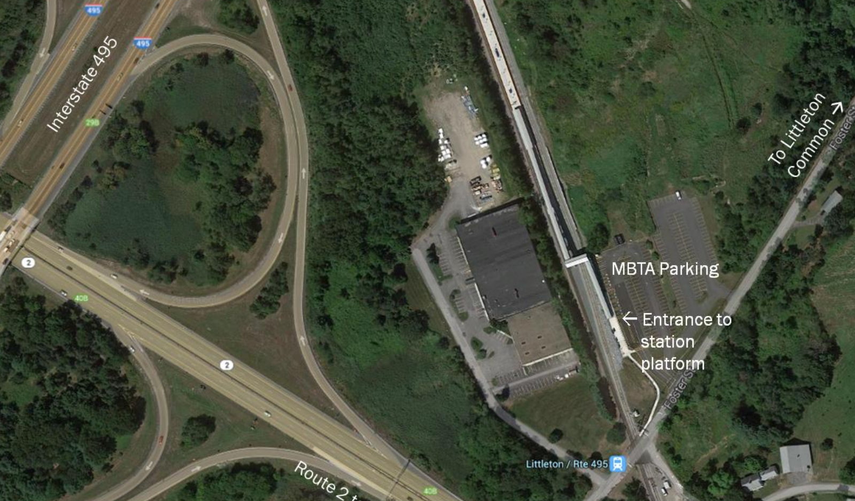
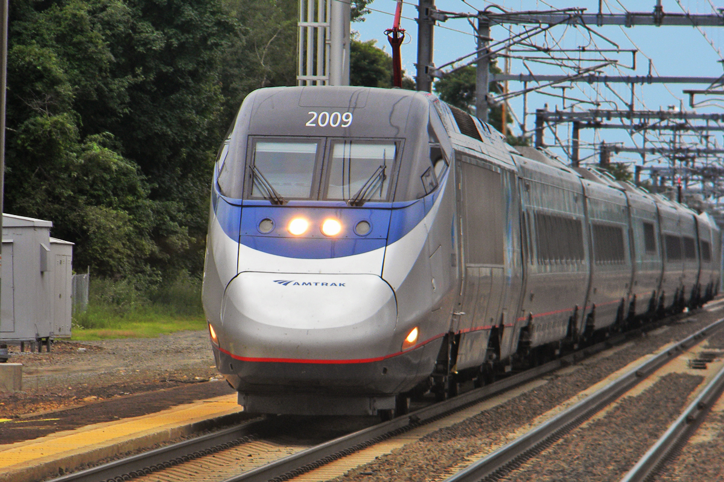
Ridership constraints vary by line.
Photo sources: www.mapc.org/wp-content/uploads/2017/11/Littleton-Commuter-Rail-Parking-Study-FINAL-10-7-14.pdf,
Shreder 9100 at English Wikipedia, CC BY 3.0, https://commons.wikimedia.org/w/index.php?curid=19261912
Notes:
Red line – access
Red line – parking
Southbridge – parking
Level boarding delays
Electrification . . . Service improvements?
Results depend on spacing; turn times
Shared freight; dispatching
Signal blocking
Number of tracks
VISION SO FAR ASSUMES PARKING . . . NEED TO DOUBLE IT TO ACHIEVE VISION . . . WHAT IF WE JUST DOUBLE PARKING AND ADD LONGER TRAINS?

Slide 17
Transit investment prioritization framework
Target Market | Goal | Planning considerations | Risks
Existing customers (reliability) | Meet obligations; sustain system | Engineering | Project design and management
Existing commuters (mode shift) | Reduce congestion; reduce GHG | . . . + ridership predictions | . . . + bad predictions
New commuters (development) | Housing, economic development | . . . + partnership plans | . . . + other partner failures

Slide 18
Line-by-line rail improvement plan
Address reliability and bottlenecks first – signals, tracks, train control
Select mode-shift investments based on lowest cost per new rider (expect will be at rush hour, so reducing congestion)
Prioritize reliability and mode-shift before development vision

Slide 19
Summary
More operational funding for MBTA
Line-by-line rail improvement plan
Next: Worcester and Fitchburg line solutions

Slide 20
Bigger picture: For GHG reduction, need to electrify private vehicles
Source: https://willbrownsberger.com/transit-energy-efficiency/

Slide 21
Additional Materials

Slide 22
Limited Capital Planning Capacity
[T]here is no question, current leadership is struggling to understand how they will deliver the accelerated Capital Program, keep legacy system assets fully functional, in addition to carrying out normal day-to-day [preventative maintenance inspections], given the current state of the Authority.
Safety Review Panel, Final Report, December 9, 2019
https://cdn.mbta.com/sites/default/files/2019-12/2019-12-09-fmcb-B-safety-review-panel-final-report-accessible.pdf

Slide 23
Policy changes to build capital capacity
Personnel Flexibility measures
Salary policy
Availability of capital funds for design work
. . .
Public private partnerships
Not anti-union
Attract broad consortia to bid for projects defined at high level

Slide 24
Other issues
Congestion pricing – create design commission
Bus lanes and signal priority – MBTA/municipal partnerships
Bicycle and pedestrian safety – pending legislation
Car free urban areas – local planning decisions

Slide 25
Regional rail – numbers
Source: Rail Vision Advisory Committee Presentation, October 18, 2019

Slide 26
Can rail reduce congestion?
Source: Congestion in the Commonwealth, page 89
Notes:
Wouldn’t do commuter rail as environmental, equity or development

Slide 27
Core Capacity
Source: https://www.ctps.org/data/calendar/pdfs/2017/MPO_0504_Report_Core_Capacity_Constraints.pdf

